Slide 1
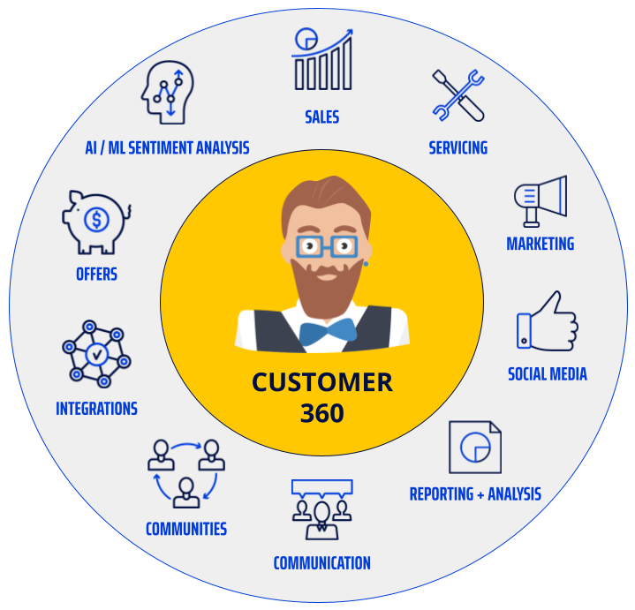
Customer 360 Report
10th Grade
Nguyễn Xuân Đồng

Slide 2
1. Problem
In the modern business environment, evaluating enormous volumes of data is essential for formulating winning plans. Big businesses are looking for more detailed information about their customers' identities, including purchase amounts, preferences, routines, and spending patterns. With the use of Customer360, an efficient instrument, organizations can better target their customers, improve service quality, and increase profitability by gaining a full view of their client base across disparate platforms.

Slide 3
2. Concept
Gathering data from several platforms to create a complete customer profile is known as the "Customer 360" approach to customer information analysis. It contains information like:
Transaction data: Information of transaction history
Interaction data: How customer interact with the service
Behavioral data: Hobbies, habits and opinions of customers
Demographic data: Data related to demographics

Slide 4
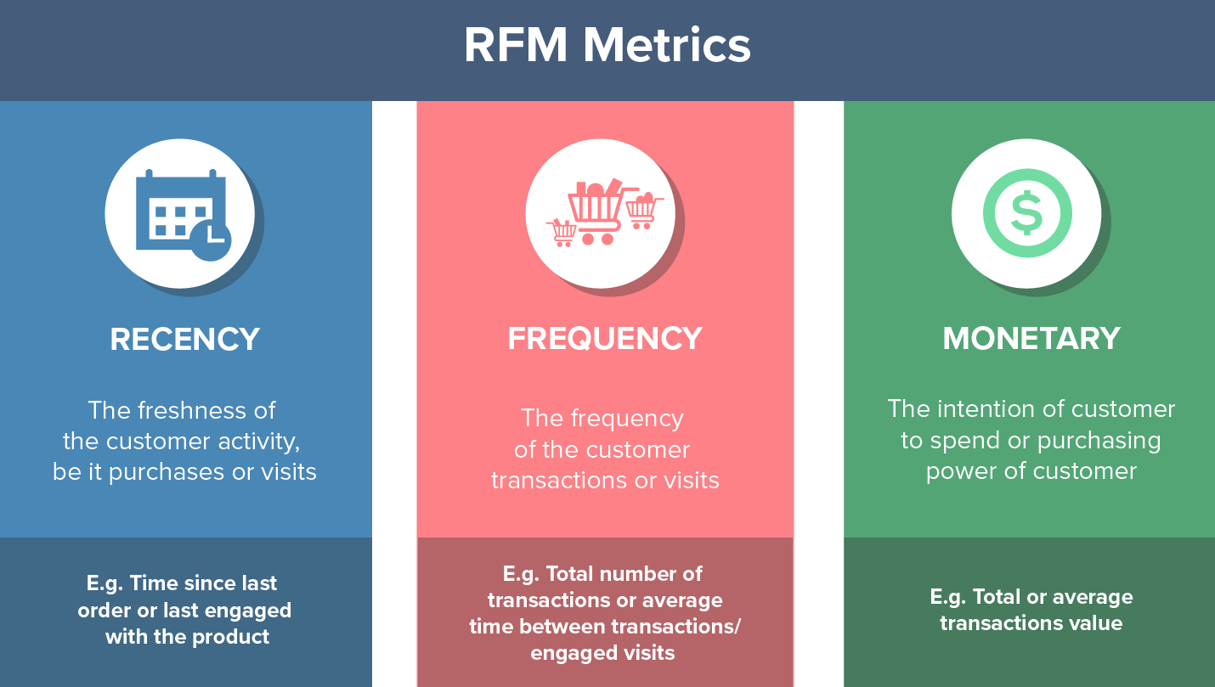
3. RFM model
RFM analysis is a marketing technique used to quantitatively rank and group customers based on the recency, frequency and monetary total of their recent transactions to identify the best customers and perform targeted marketing campaigns. The system assigns each customer numerical scores based on these factors to provide an objective analysis.

Slide 5
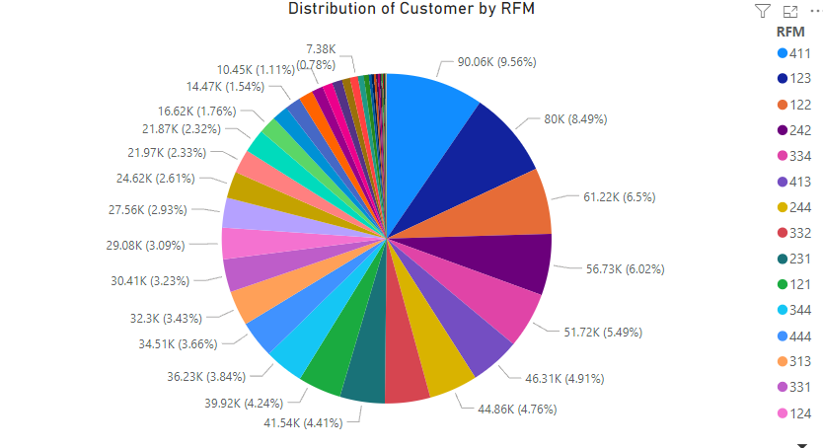
Division of value in RFM
 | R | F | M
min | 1 | 1 | 0
25% | 21 | 2 | 70000
50% | 43 | 3 | 75000
75% | 67 | 4 | 95000
max | 92 | 6 | 8400000

Slide 6
Division of value in RFM
The database is comprised of 1,043,849 transactions from June 1, 2022, to September 1, 2022, including 942,340 clients (meeting the GMV per transaction > 0) in total. The following divisions apply to the RFM scoring scale:
Recency:
Segment 1: Last purchase occurred between 67 to 92 days ago
Segment 2: Last purchase occurred between 43 to 68 days ago
Segment 3: Last purchase occurred between 21 to 42 days ago
Segment 4: Last purchase occurred between 1 to 20 days ago
Frequency:
Segment 1: Number of purchases is 1 time
Segment 2: Number of purchases is 2 times
Segment 3: Number of purchases is 3 times
Segment 4: Number of purchases is 4 times or more
Monetary:
Segment 1: Total shopping expenditure < 70000
Segment 2: Total shopping expenditure between 70000 and 750000
Segment 3: Total shopping expenditure between 750000 and 95000
Segment 4: Total shopping expenditure > 95000

Slide 7
Segmentation
Champions | 444 | Bought recently, buy often and spend the most
Potential loyal | 332, 333, 334 | Recent customers, spent good amount, bought more than once
Loyal customers | 222 223 233 232 322 | Spend good money. Responsive to promotions
Promising | 311, 312, 321 | Recent shoppers, but haven’t spent much
New customer | 411, 421, 431, 412, 413, 414 | Bought more recently, but not often
Can't lose them | 134 ,133 | Made big purchases and often, but long time ago
Need attention | 131, 132, 141, 142, 143, 144 | Above average recency, frequency & monetary values
At risk | 124, 123 | Spent big money, purchased often but long time ago
About to sleep | 211, 212, 213, 221 | Below average recency, frequency & monetary values
Lost | 111, 112, 113, 121, 122 | Bought a long time ago, average amount spent

Slide 8
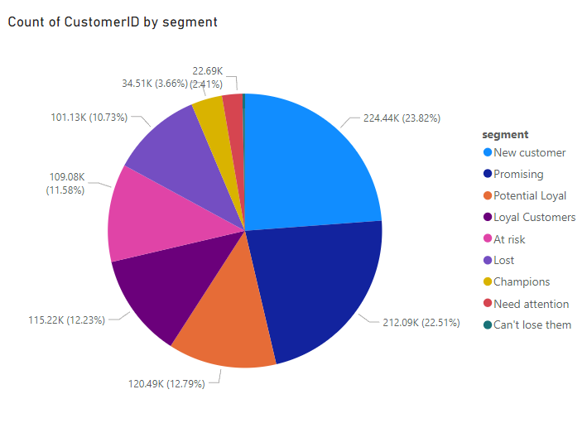
Analysis and Solution
Need Attention (2.41%) is the customer sector with the fewest customers, while New Customers (23.82%) is the segment with the most consumers.
Since fresh segments make up the majority of our customers, we ought to:
Run internet marketing campaigns on Facebook, Tiktok, and other sites.
Put special offers and discounts into action
Attend events such as fairs and exhibitions to draw in more
However, 10.73% of the segment is made up of lost customers. and usage risk up to 11.58% for the consumer segment. Given such a situation, we ought to
Ask clients about their architectural preferences
Raise the caliber of goods and services
Review the range of prices for goods and services.

Slide 9
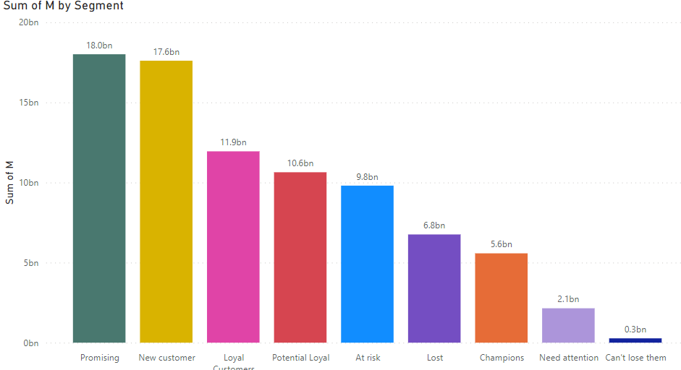
Analysis and Solution
- Compared to the other segments, the Promising customer section has a value of 18 billion VND, while the New customer sector has a value of 17.6 billion VND.To satisfy the requirements of consumers in the Promises and New customers sectors, we should regularly create and update new programs and products.
- This will help the former group of customers grow into loyal, long-term supporters, much like the Loyal Customer and Champion
- Additionally, we can observe that they spend a significant sum of money on goods and services in the At risk and Lost divisions.
Customers may become unsatisfied or even develop a negative opinion of the service or product after using it a few times, in which case we should:
Conduct customer surveys
Add emails to receive feedback from customers

Slide 10
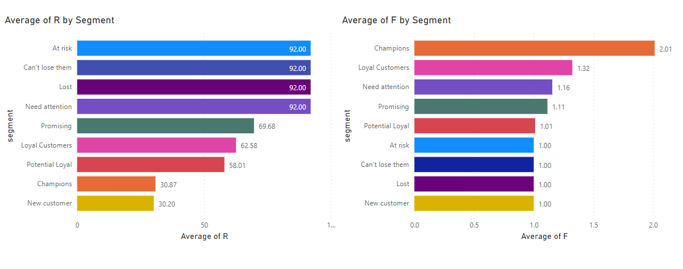
Analysis and Solution
The four segments At risk, Can't lose them, Lost, and Need attention all have equal average Recency indexes in the Recency section. This indicates that the remaining three segments are most likely to become Lost. Other than Champion, the remaining segments in the frequency section have relatively low frequency indexes; to get clients to return and spend more, we should host a lot of events, introduce new products, and offer new services.

